Slide 1

B.Tech Project Evaluation GSM-Based Automatic Alarm System For Disaster Management
Presented by :-
Vibhu Singh, VanshPanwar,
Karan
Under the Supervision of:-
Dr. Mandeep Kaur
Sharda University,
Gr. Noida
DEPARTMENT OF COMPUTER SCIENCE & ENGINEERING
SCHOOL OF ENGINEERING AND TECHNOLOGY
1

Slide 2
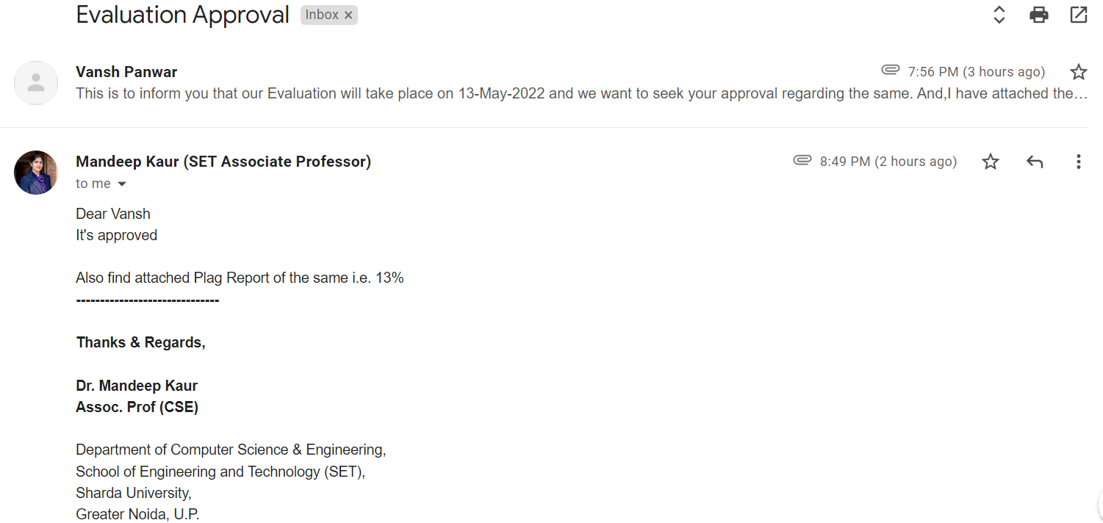
Approval from guide for the evaluation

Slide 3
Contents of the Presentation
Introduction
Motivation to research problem
Objectives overview
Components
Working Principle
Circuit Simulation Diagram (half implementation)
Results and output
Project latest images Application
Conclusion

Slide 4

Introduction and origin of the research problem
Nowadays, Gas leakage is a serious problem observed in many places like industries, residence and Compressed Natural gas (CNG) vehicles like cars, buses, etc. It observed that due to gas leakage many dangerous accidents occur.
These gases catch fire easily due to that any leak that occurs may lead to an explosion. It led to various accidents resulting in injuries and material loss.

Slide 5
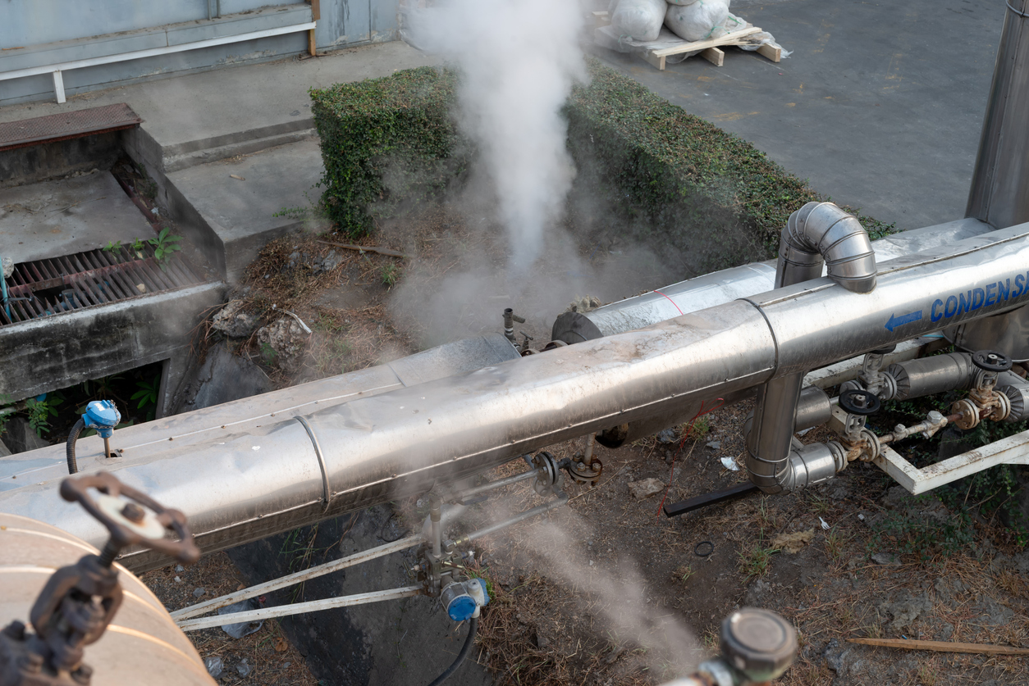
The number of deaths increases due to the explosion of LPG and the threat to human lives has been growing in recent years.
To avoid this problem, the project entitled ”gsm - based automatic alarm system for disaster management” give great help in term of preventing any explosion and accident caused by gas leakage. The purpose of this project is to detect the leakage of gas to prevent any accident occur.

Slide 6
Motivation to research problem
Gas leakage is a major problem which causes vulnerable accidents in the domestic areas, residential premises, industrial sector, etc. Nowadays, home security has become a major issue because of increasing usage of LPG pipelines and hence leakage has become a common issue.
Liquefied Petroleum Gas (LPG) is the source of fuel which is used especially in urban areas because it is clean compared to firewood and charcoal. Gas leakage is a source of great anxiety within residential areas, studios and vehicles like Compressed Natural Gas (CNG), buses, and cars which are run on gas power.

Slide 7
Objectives overview
The objective of proposed project is to discuss and implement a design, functioning and future scope of a gas leakage detection system that can automatically detect, alert the user by sending message using GSM module, ring buzzer alarm to alert people present locally at the location and control gas leakage (by exhaust functionalities).
The gas leakage security system is based on a gas-sensor that easily detects a gas leakage (LPG, smoke, etc.). The most straight forward method to prevent accidents associated with the gas leakage is to install a gas leakage detection kit like our project, at vulnerable places.

Slide 8
Objectives
The main objective of our system is to design/built a GSM-based automatic alarm system for disaster management, at a minimal cost with providing maximum benefits.
Detect gas leakage like LPG using LPG gas sensor and Arduino.
Buzzer-produce alert sound on gas leakage.
Red LED will on when system detect gas leakage
Message send to the user by using GSM module
Exhaust fan automatically turn on whenever the gas leakage detected
It will connect to the owner as soon as possible to take further steps of prevention.

Slide 9
Components
Bread Board
Gas Sensor MQ 135
Arduino
Jumper Wires
LED

Slide 10

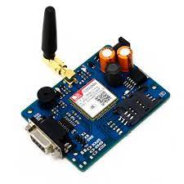
Components
Buzzer Alarm
Exhaust fan
GSM module

Slide 11
Working Principle
This framework depends on the Arduino UNO R3, MQ-6 gas sensor, photoelectric detector, GSM module and an exhaust fan.
At the point when the sensor identifies gas in the climate, (it will give computerized yield 1 and if gas in not recognized the sensor will give advanced yield 0. Arduino will get the sensor yield as computerized input.)
On the off chance that the sensor yield is high, at that point the ringer will begin tuning alongside the LCD that will show that "Gas recognized: Yes".
By the help of GSM module alert message send to the user and near gas station and simultaneously exhaust system will work.
Also, the GSM module will connect a call to fire extinguishing department with owner to take further action.
In the event that the sensor yield is low then ringer won't tune, and the LCD will show that "Gas distinguished: No".
11
Notes:
11

Slide 12
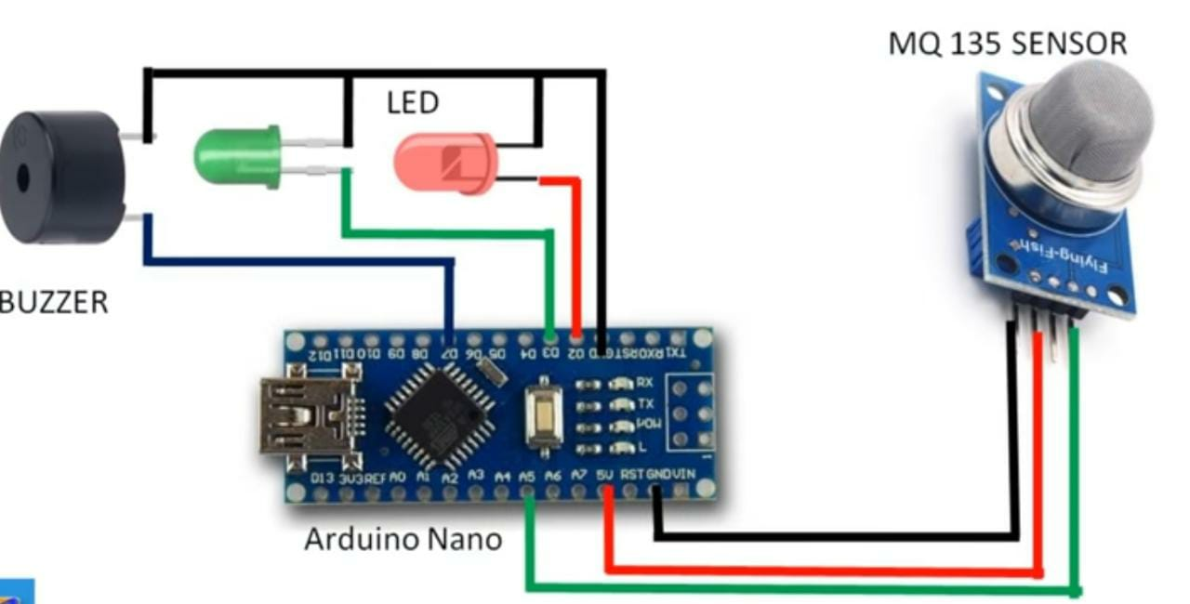
Circuit Simulation Diagram (half implementation)

Slide 13
Results and output
The proposed work has many objectives that have been attained by successfully implementing the system. The objectives are as follows:
To design/built a GSM-based automatic alarm system for disaster management, at a minimal cost with providing maximum benefits.
Detect gas leakage like LPG using LPG gas sensor and Arduino.
Buzzer-produce alert sound on gas leakage.
Red LED will on when system detect gas leakage.

Slide 14
Results and output
Message send to the user by using GSM module.
Exhaust fan automatically turn on whenever the gas leakage detected.
It will connect to nearby fire departments and get a call back from fire extinguishing department to the owner as soon as possible to take further steps of prevention.

Slide 15
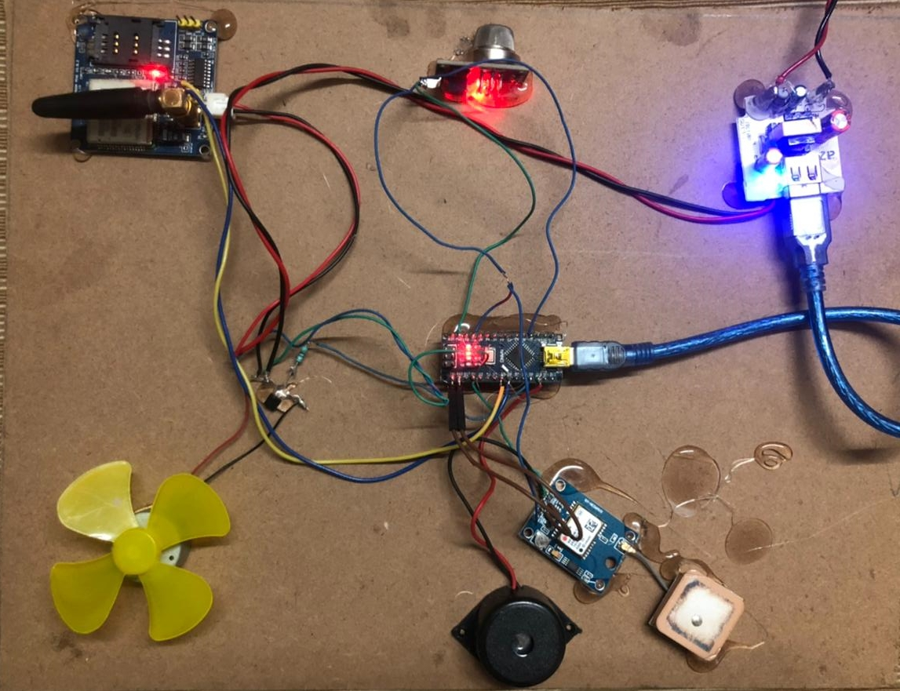
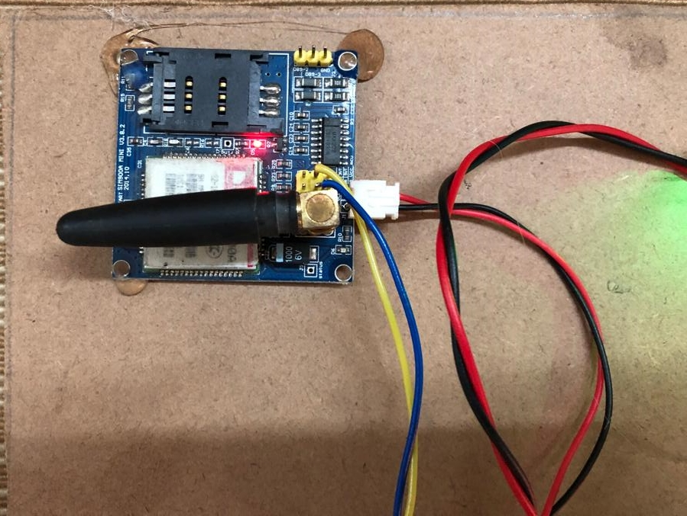
Project latest images

Slide 16
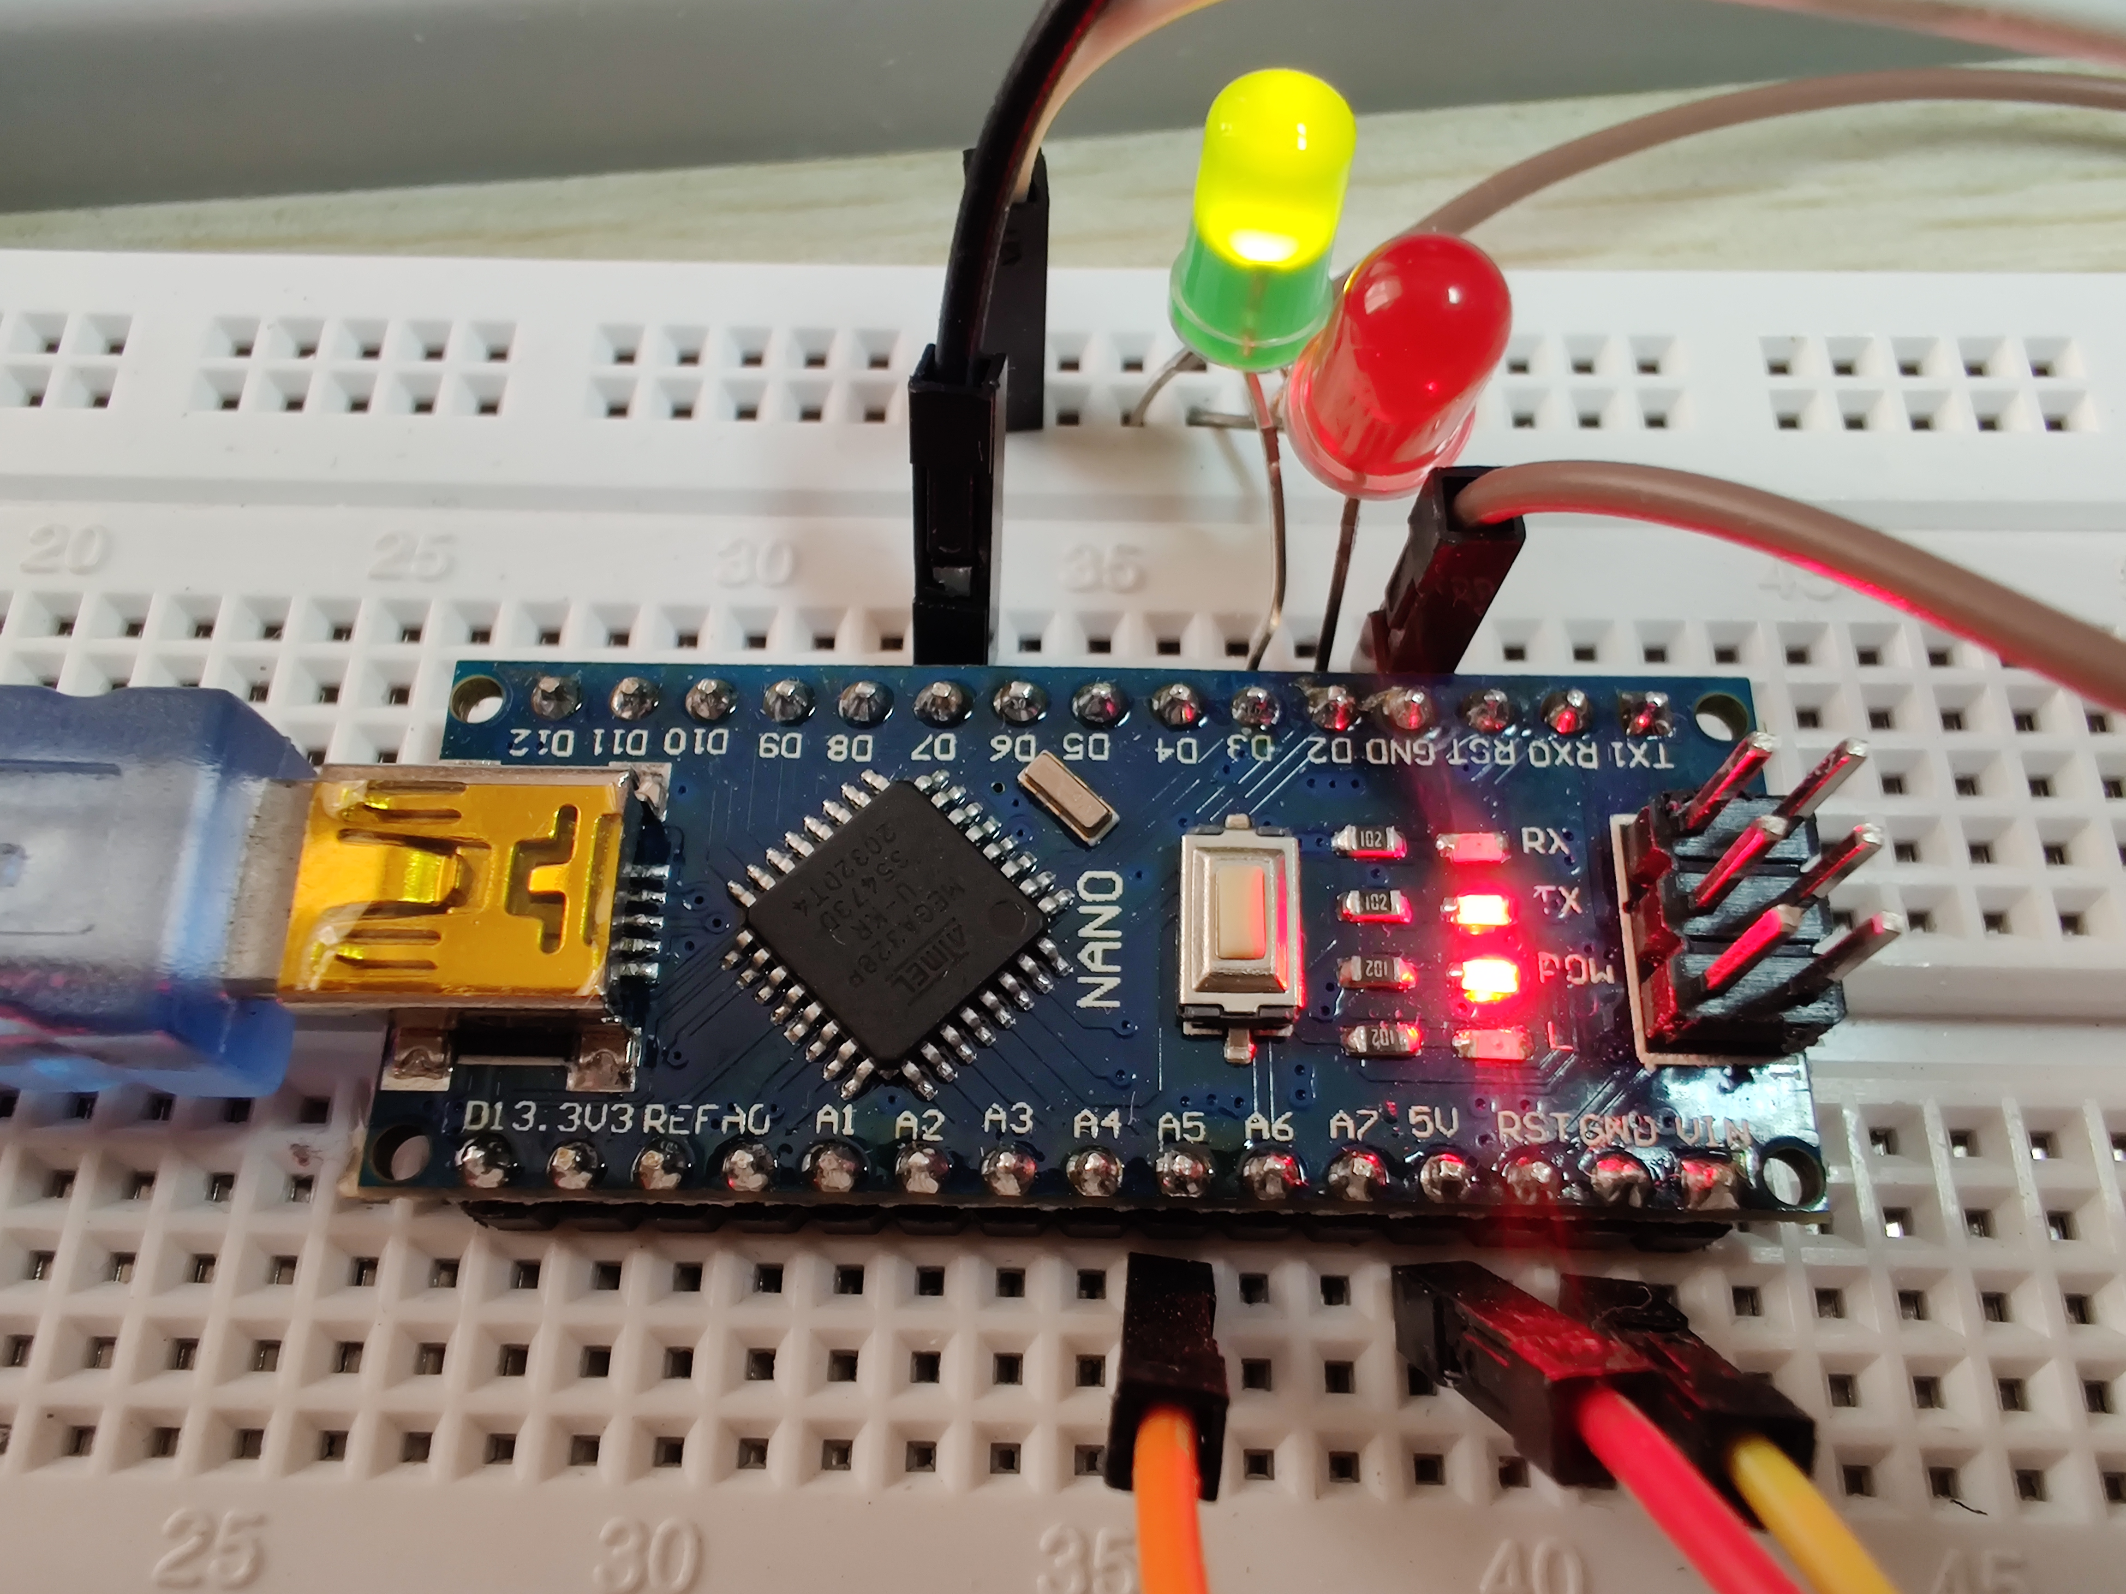

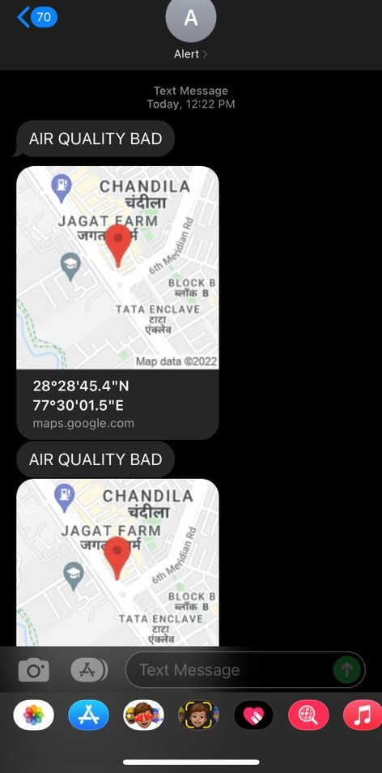
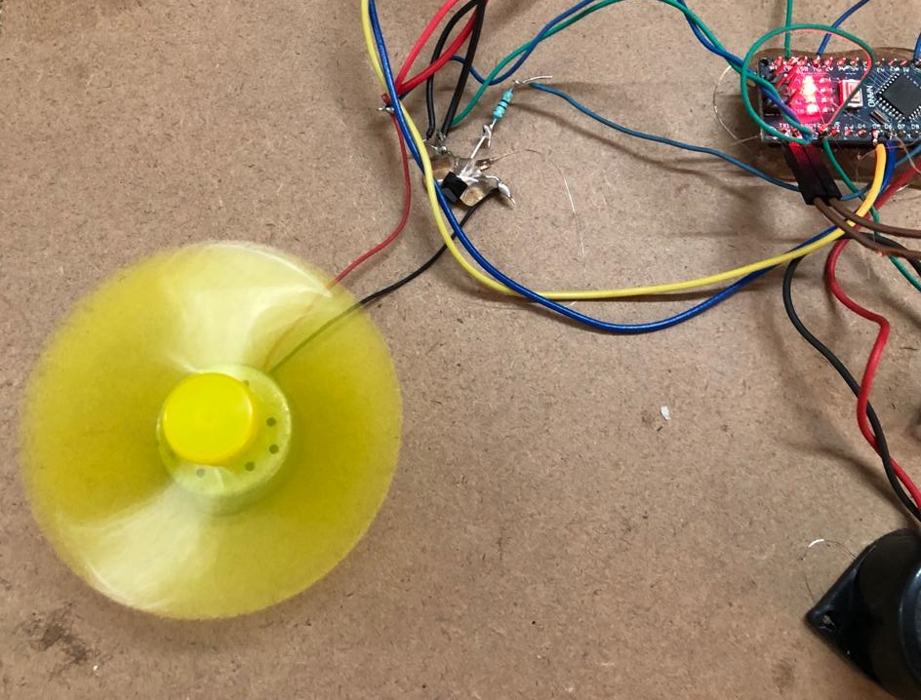

Slide 17
APPLICATION
Home security; The system is designed mainly for home (especially kitchen area) to prevent accidents due to gas leak.
Underground parking
Laboratories
Refrigeration plants
Refineries
Sewage treatment plants
And many more like Power plants, Textile industry, Steel industry, Wine Cellars.

Slide 18
CONCLUSION
The LPG is now being used in everywhere – at home, car and even in hospital, hotel etc. There are many cases of major accidents caused by Gas leakage. Since there are provision of ‘Buzzer” as well as “ALERT notification” which is visible in mobile through Bluetooth form some distance, hence its usefulness will be tremendous.
With our project we could be able to prevent all types of accidents due to leakage of LPG.

